Slide 1
UE20CS302: Machine Intelligence
Project Phase – 1
Project Title : Image Classification Using Convolutional Neural Network
Project ID :
Project Team : Gautam R A (PES1UG20CS151)
Gurukiran V (PES1UG20CS156)
Jayasimha S (PES1UG20CS177)

Slide 2
Abstract and Scope
Problem statement.
Building a deep image classifier using CNN(Convolutional Neural Network)
Introduction:
Classification between objects is a complex and tedious task. Therefore image classification has been an important task within the field of computer vision. Image classification refers to the labelling of images into one of a number of predefined classes. There are potentially n number of classes in which a given image can be classified. Manually checking and classifying images could be a tedious task especially when they are massive in number and therefore it will be very useful if we could automate this entire process using the deep learning algorithm of Convolutional Neural Networks.

Slide 3
Design Approach
Algorithm Used : Convolutional Neural Network , TensorFlow
CNNs are used for a variety of tasks in computer vision, image classification and object detection , TensorFlow framework enables to create highly flexible CNN architectures for computer vision tasks.
The CNN classifier is first trained on a set of known data pertaining to different class of objects , using multiple layers in the neural network we have greatly reduced the dimensions of the image, we can use the tightly meshed layers. Here, the individual sub-images are linked again in order to recognize the connections and to carry out the classification

Slide 4
Design Approach
Benefits:
TensorFlow has a better data visualization power than any other available library. This makes it working on neural networks easier.
It is compatible with many programming languages like Python, C++, JavaScript, etc. This allows users to work in an environment they are comfortable in.
It is compatible with many programming languages like Python, C++, JavaScript, etc. This allows users to work in an environment they are comfortable in.
The main strengths of CNNs are to provide an efficient dense network which performs the prediction or identification etc. efficiently.
The power of CNN is to detect distinct features from images all by itself, without any actual human intervention

Slide 5
Drawbacks:
It is comparatively slower and less usable compared to its competing frameworks.
TensorFlow’s TPU architecture allows only execution of models and doesn’t allow its training.
A Convolutional neural network is significantly slower due to an operation such as maxpool.
A Convolutional neural network requires a large Dataset to process and train the neural network.
Alternative Design Approach:
Using transfer learning we could train a model which is much better when compared to CNN model.

Slide 6
Design Constraints, Assumptions & Dependencies
Design Contraints:
CNN do not encode the position and orientation of object. Lack of ability to be spatially invariant to the input data
A CNN requires a large Dataset to process and train the neural network.
A Convolutional neural network is significantly slower due to an operation such as maxpool. If the CNN has several layers then the training process takes a lot of time if the computer doesn't consist of a good GPU.
Assumptions:
The Image we are trying to classify is assumed to belonging to one of the classes we have trained our model to classify.

Slide 7
Proposed Methodology / Approach
New Approach:
Transfer learning is a method of reusing the already acquired knowledge, we assess that the pretrained model may not be directly applicable to our problem. But, we can use it to get a useful representation of our input data. We feed input data to pretrained model to get a representation of our data.
We design our own model and feed it with representations given by pre-trained model to get results.
Benefits:
Versatile uses cases from transfer learning, prediction, and feature extraction
achieve solid (same or even better) model performance quickly.
Drawbacks:
Many pre-trained models are trained for less or mode different purposes , so may not be suitable in some cases
It will take large amount of resources(time and computation power) to train big models from scratch

Slide 8
High-level design view of the system.
High Level Design - Overview
We(project developers) select the dataset in which we want to train our deep neural network.
Once datasets has been selected we check the datasets for dodgy images and get rid of them.
This cleaned datasets are provided as input to the preprocessor which scales and partitions the datasets into training ,testing and validation sets.
After this we build the deep neural network and train it using the training set of images.
Once it has been trained its performance is evaluated using the test set.
Once the model has been tested it is combat ready and can be deployed to the user.

Slide 9
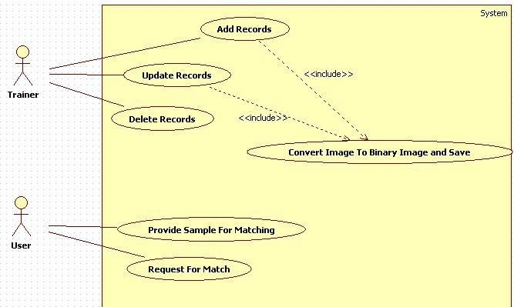
Design Description
Master class diagram

Slide 10
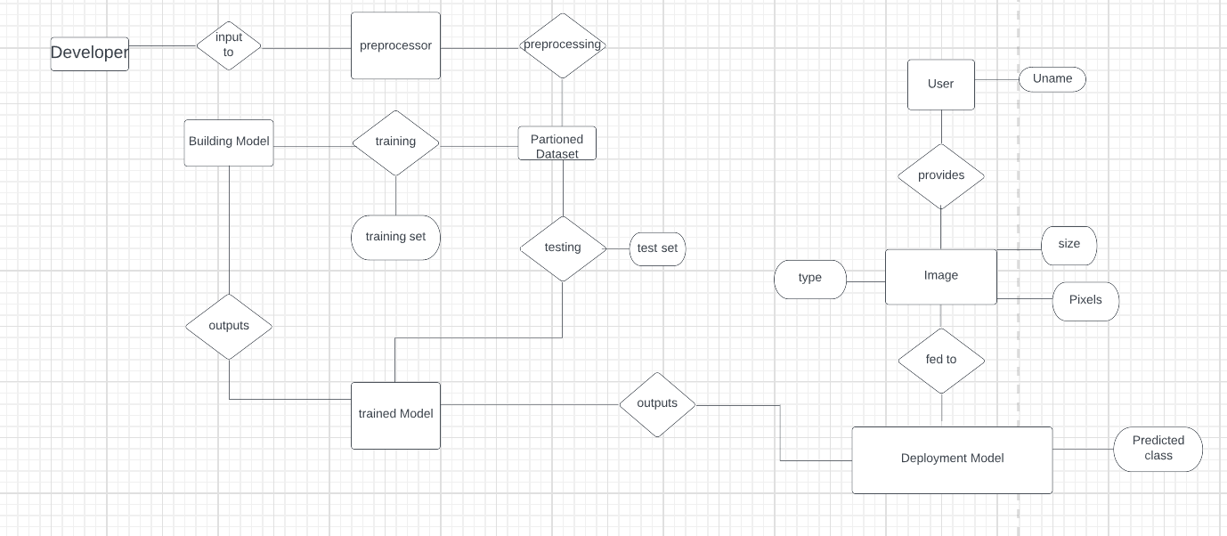
ER Diagram

Slide 11
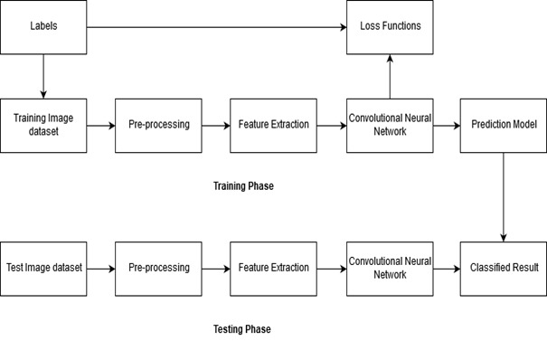
User Interface Diagrams/ Use Case Diagrams

Slide 12
External Interfaces
Once our deep neural network is trained with the necessary classes of image datasets, the user is asked to provide a random image of his choice from the classes of images our neural network is trained in.
After he has provided the input image, it will be fed to the trained Deep neural network we have created and the output(i.e the predicted class of the image) will be display to the user.

Slide 13
Technologies Used
Tensor flow : It is an open source library developed by Google primarily for deep learning applications. Tensorflow has a better data visualization than any other library. This makes it working on neural networks easier.
Keras : is an high level API for TensorFlow, it is an approachable and highly productive interface for solving classification problems.
Conv2D : is a 2D convolutional layer, which creates a convolutional kernel that is convolved with the input layer to produce tensor of outputs.
Max Pooling
CV2 : OpenCV function
Sequential is an API of TensorFlow which allows us to create models layer by layer.
Dense : layer is used to classify image based on output from convolutional layers.
Flatten is used for converting multi-dimensional array into one dimensional flatten array or single dimensional array.
Activation functions : Sigmoid and ReLU
Optimizer : Adam

Slide 14
References
Provide references pertaining to your research according to IEEE format.
Example:
G. Eason, B. Noble, and I. N. Sneddon, “On certain integrals of Lipschitz-Hankel type involving products of Bessel functions,” Phil. Trans. Roy. Soc. London, vol. A247, pp. 529–551, April 1955. (references)

Slide 15
Any other information
Provide any other information you wish to add on.

Slide 16
Thank You

